Slide 1

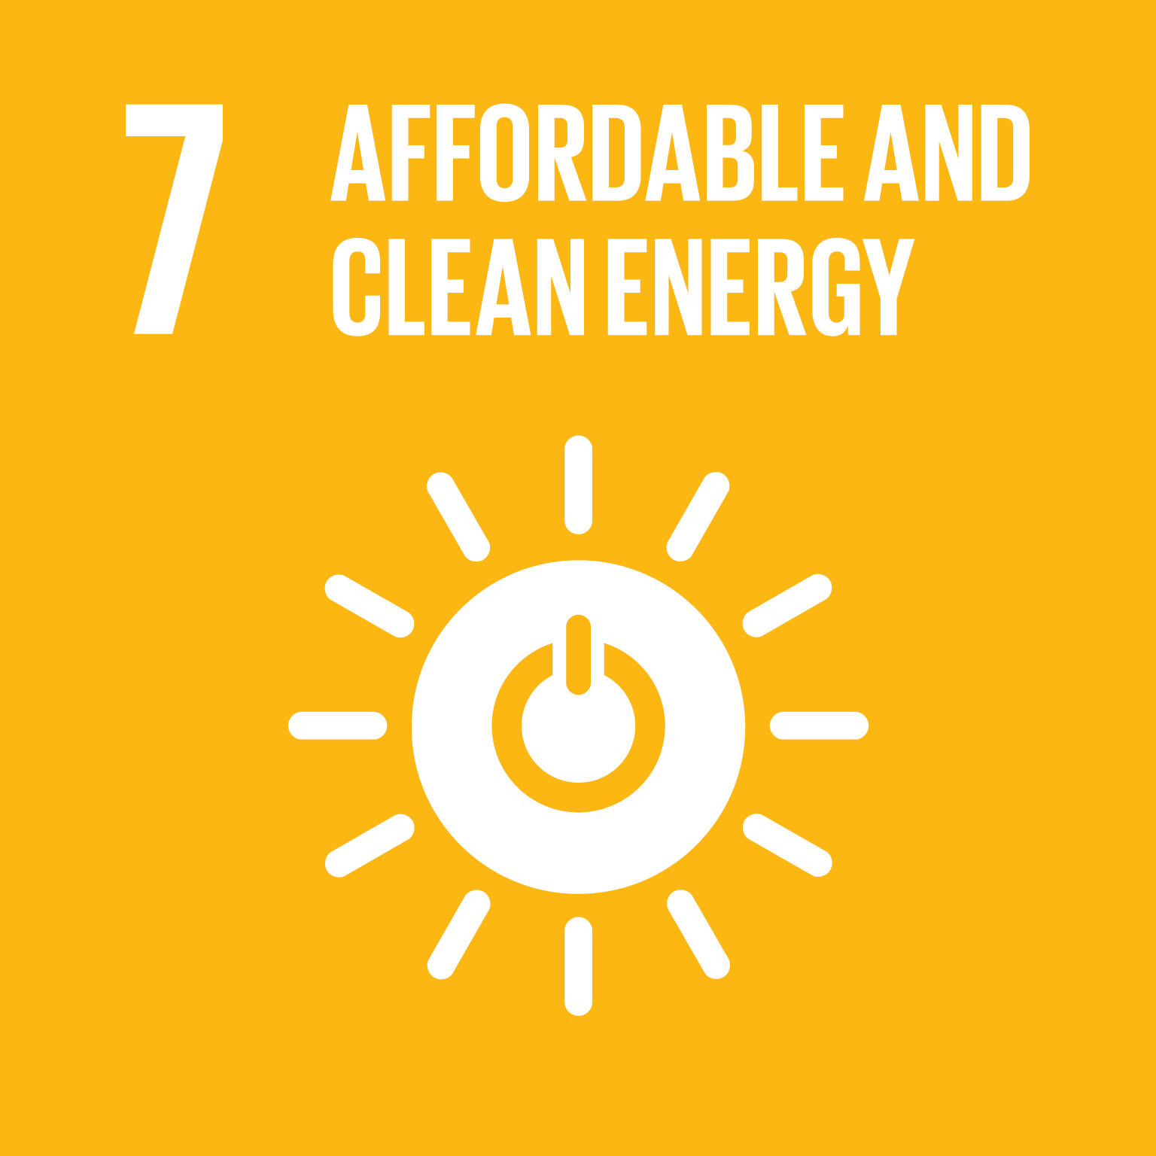
STRENGTHENING INTERLINKAGES BETWEEN SDG7 AND OTHER SDGS
Policy Brief #12
Global Progress of SDG7 - Energy and Gender
Notes:
Priority actions over the next 4 years
• National governments must take the lead in developing human and institutional capacities in support of the energy transformation, advanced through a coordinated approach by development pa rtners.
• Establish a platform or integrate/consolidate existing platforms and institutions dealing with capacity building. The focus needs to be on integrated multi - stakeholder approaches to designing capacity building plans, with holistic, gender - inclusive , integrated frameworks for SDG 7 in a relevant global institution.
• Effect CB at the country and regional level by designating national focal institutions and adequately resourcing them. These institutions would have responsibility for: undertaking integr ated CB needs assessments at various levels, involving policy makers, the private sector, academia and communities; determining the delivery mechanisms; and putting in place exacting monitoring and dynamic tracking mechanisms. The broader and integrated ap proach needs to be complemented with targeted and specialised SDG 7 capacity building, with specialised agencies and institutions.
• Define cross - sectoral integrated targets between SDG7 and other SDGs, and track their achievement through an appropriately d esigned monitoring and evaluation framework.
Priority actions towards 2030
• Create a network of the global and national institutions identified above to institutionalise CB for SDG7 and related SDGs. This Network should evolve to function as a:
a) Knowledge bank: repository for contextually - mapped knowledge resources on policies, regulations and actions for energy access, energy efficiency, renewable energy;
b) Clearinghouse(s): platform for active information and experience exchange at international, regional , national, subnational or local levels;
c) Resource centre: provide on - line tools for CB needs assessments to facilitate project development, resource assessments, access to finance, public - private partnership models; and
d) Help desk: an on - line help desk fo r customising actions/interventions at the local level.
• Refresh and re - align the curriculum in higher education institutions including doctoral and post - doctoral works to better respond to the needs of SDG 7 and related goals.
1

Slide 2

POLICY BRIEF #12 Global Progress of SDG7 - Energy and Gender
CURRENT STATUS
1 billion + lack access to electricity
Close to 3 billion lack access to clean cooking
Women bear the greatest burden of this energy poverty
Household air pollution is responsible for about 2.8 million deaths every year, mostly among women and children
Under current policies and trends, 2.3 billion people will still lack access to clean cooking facilities in 2030.
A number of actors have started working on the intersection of gender, energy and sustainable development, and in advancing gender equality, social inclusion, and women’s empowerment in the energy sector.
Developed by ENERGIA, World Bank Group/ESMAP and UN Women
In collaboration with SEforAll and IEA
Notes:
Status of gender and energy and progress towards achieving SDGs
Over one billion people in the world lack access to electricity, and close to 3 billion lack access to clean cooking. Women bear the greatest burden of this energy poverty – it is their unpaid time and labour that is expended to gather biomass fuels for cooking, collect water, or manually process grains and other foods. Household air pollution, linked to burning fuels such as wood, animal waste and charcoal, is responsible for about 2.8 million deaths every year, mostly among women and children.
Greater access to energy services can improve women’s health and wellbeing, free up their time, and enable their economic empowerment, thereby supporting the achievement of SDG 5.
While some countries and regions are on track to achieve electricity for all, under current policies and trends, 2.3 billion people will still lack access to clean cooking facilities in 2030. In recent years, going beyond their traditional role as “users” and “beneficiaries,” women are playing a role in expanding energy access—thereby becoming part of the solution. A number of actors have started working on the intersection of gender, energy and sustainable development, and in advancing gender equality, social inclusion, and women’s empowerment in the energy sector.
The IEA finds that 2.8 billion people lack access to clean cooking (2.5 billion rely on the traditional use of solid biomass, 120 million on kerosene, 170 million on coal). See IEA Energy Access Outlook 2017, iea.org/energyaccess. Global Tracking Framework figure is 3.04 billion.
1

Slide 3
POLICY BRIEF #12 Global Progress of SDG7 - Energy and Gender
PRIORITY ACTIONS
Integrate gender and energy actions within all SDGs, and establish gender-responsive global and national energy sector policies backed by evidence.
Ensure equal participation of women in decision-making bodies in energy institutions
Reduce barriers in energy industry for women, and increase their representation on national and global energy bodies
Promote and invest more in clean cooking technologies and decentralised sustainable energy technologies that support gender equality and women’s economic empowerment
Empower women in the design, production and distribution of modern energy services
Developed by ENERGIA, World Bank Group/ESMAP and UN Women
In collaboration with SEforAll and IEA
Notes:
Priority Actions
Integrate gender and energy actions within all SDGs, and establish gender-responsive global and national energy sector policies backed by evidence, such as sex-disaggregated data and analysis. Continue to build expertise and experience on gender issues across the energy value chain, from off-grid distribution and consumption to policy/pricing to generation and energy production. Energy sector institutions including energy ministries and utilities should be supported in developing gender-responsive programmes, monitoring systems and data collection methods.
Promote and invest more in clean cooking technologies and decentralised sustainable energy technologies that support gender equality and women’s economic empowerment, involving women in the design and distribution of modern energy equipment and services. Within the energy industry itself, barriers to women executives, entrepreneurs and employees must fall, and their representation on national and global energy bodies grow.
Governments must raise their efforts to promote women-centric business models for expanding energy access to all, including at the last mile, through capacity building, partnerships with local stakeholders, expanding women’s access to finance, and building a conducive enabling environment for women entrepreneurs.
International and national energy and climate change programmes and mechanisms such as the Green Climate Fund and Nationally Determined Contributions must be supported to meaningfully integrate gender concerns in programming.
1

Slide 4
POLICY BRIEF #12 Global Progress of SDG7 - Energy and Gender
PRIORITY ACTIONS
Establish financing schemes to support gender-specific programmes and women’s access to capital.
Raise efforts to promote women-centric business models and develop women’s technical and business skills
Support international and national energy and climate change programmes and mechanisms to integrate gender concerns in programming
Develop gender-responsive policies, programmes and monitoring systems
Ensure sex disaggregation and gender analysis of data to monitor SDG 7
Support international and national energy and climate change programmes and mechanisms to integrate gender concerns in programming
Developed by ENERGIA, World Bank Group/ESMAP and UN Women
In collaboration with SEforAll and IEA
Notes:
Priority Actions
Integrate gender and energy actions within all SDGs, and establish gender-responsive global and national energy sector policies backed by evidence, such as sex-disaggregated data and analysis. Continue to build expertise and experience on gender issues across the energy value chain, from off-grid distribution and consumption to policy/pricing to generation and energy production. Energy sector institutions including energy ministries and utilities should be supported in developing gender-responsive programmes, monitoring systems and data collection methods.
Promote and invest more in clean cooking technologies and decentralised sustainable energy technologies that support gender equality and women’s economic empowerment, involving women in the design and distribution of modern energy equipment and services. Within the energy industry itself, barriers to women executives, entrepreneurs and employees must fall, and their representation on national and global energy bodies grow.
Governments must raise their efforts to promote women-centric business models for expanding energy access to all, including at the last mile, through capacity building, partnerships with local stakeholders, expanding women’s access to finance, and building a conducive enabling environment for women entrepreneurs.
International and national energy and climate change programmes and mechanisms such as the Green Climate Fund and Nationally Determined Contributions must be supported to meaningfully integrate gender concerns in programming.
<Foliennummer>

Slide 5



