Slide 1
WOMEN’S MAJOR GROUP CONTRIBUTIONS TO CPR
5th October 2017
1430-1500 Hrs
By Asha Abdulrahman

Slide 2
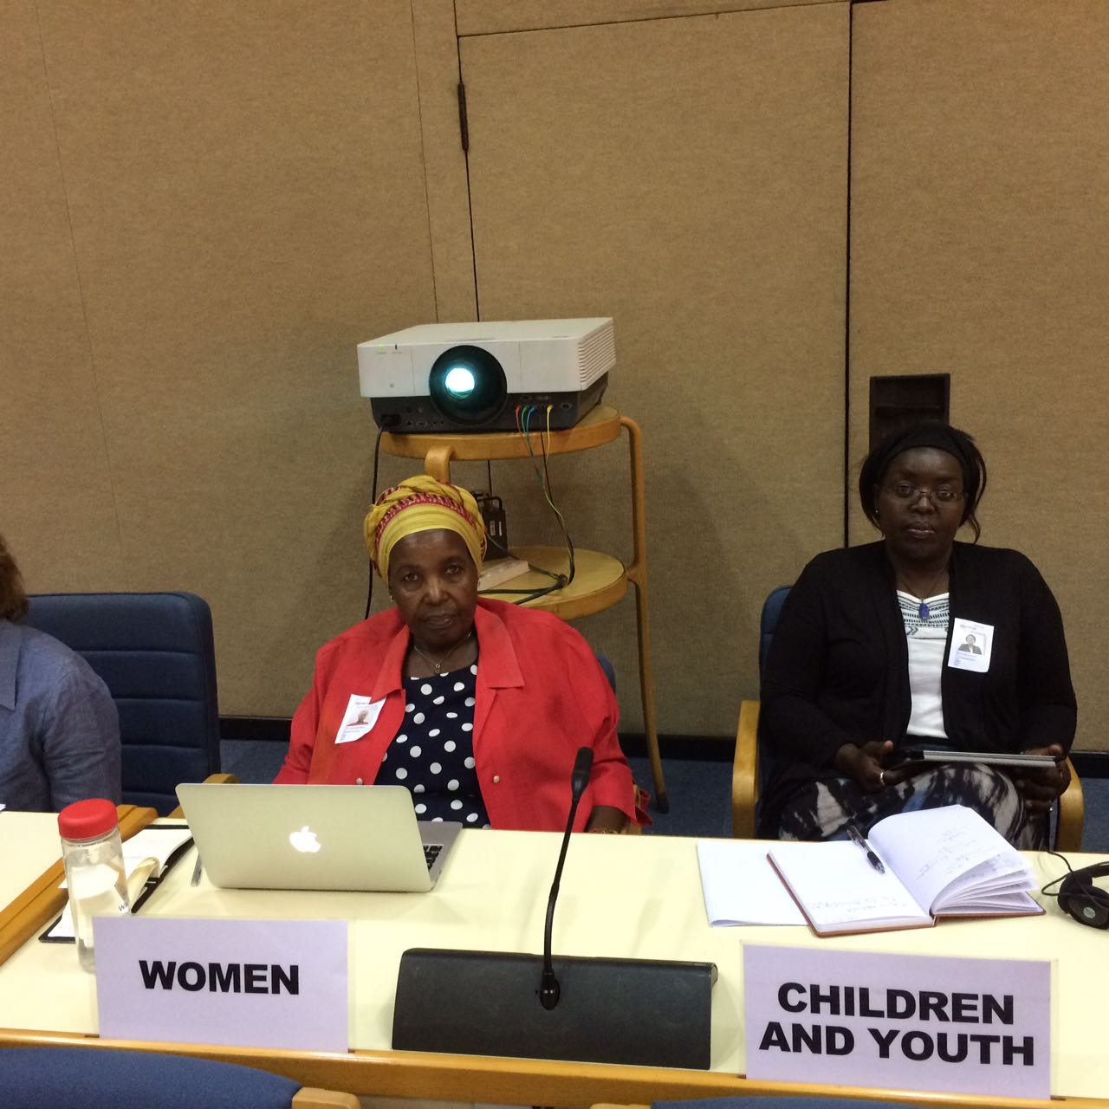
ROAD TO UNEA-3
opportunity for enhancing transparency and ensuring that No One is Left Behind.
OFFER OUR support to ensure UNEA-3 success leading to a genuinely ‘Pollution Free Planet’.
different forms of pollution pose a grave threat to human health, especially women and girls

Slide 3
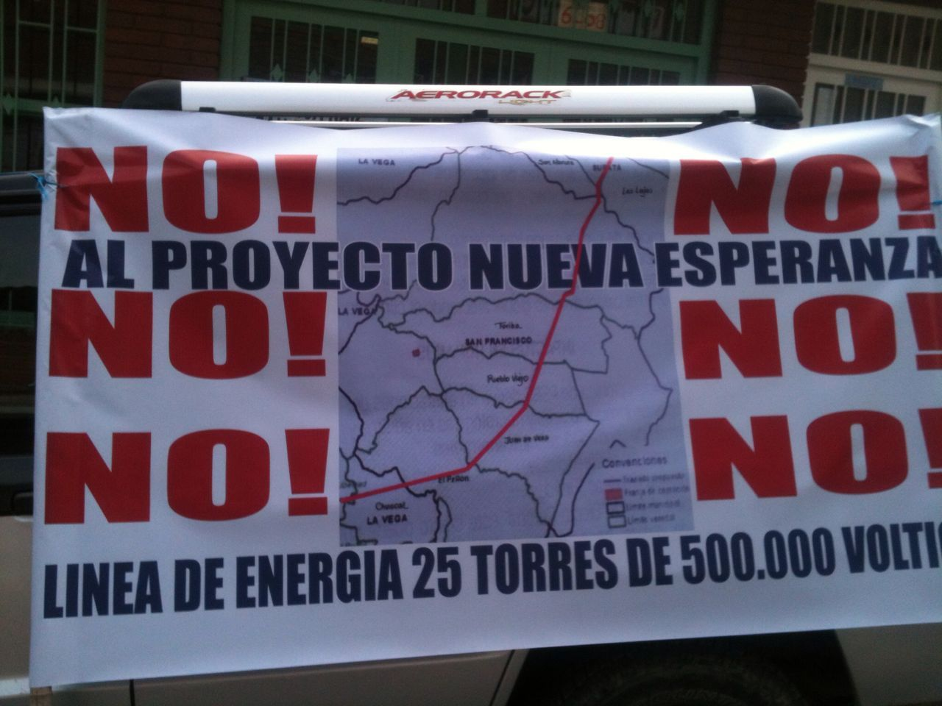
Declaration lacks some of the most pressing CHALLENGES if goal of ending pollution in all its forms is to be achieved
UNEA-3 SHOULD ADDRESS WITH Non-conventional forms of pollution, such as genetic, nuclear, electromagnetic pollution as well as pollution coming from geo-engineering and other climate related technologies
Similarly, the livestock industry is increasingly recognized as a major source of water, air and soil pollution and one of the leading contributors to climate change.

Slide 4
language in outcome documents should reflect diversity of stakeholders, including by highlighting the vital role that women from indigenous and local communities have played in curbing pollution.
Women’s and men’s health is affected differently by pollution
most victims from air, water and food pollution continue to be women and girls.
air pollution: around 4 million people die annually, mostly women and children who spend the most time around the family cookstove—inhaling soot-filled smoke in a brew of other toxic and carcinogenic compounds.

Slide 5
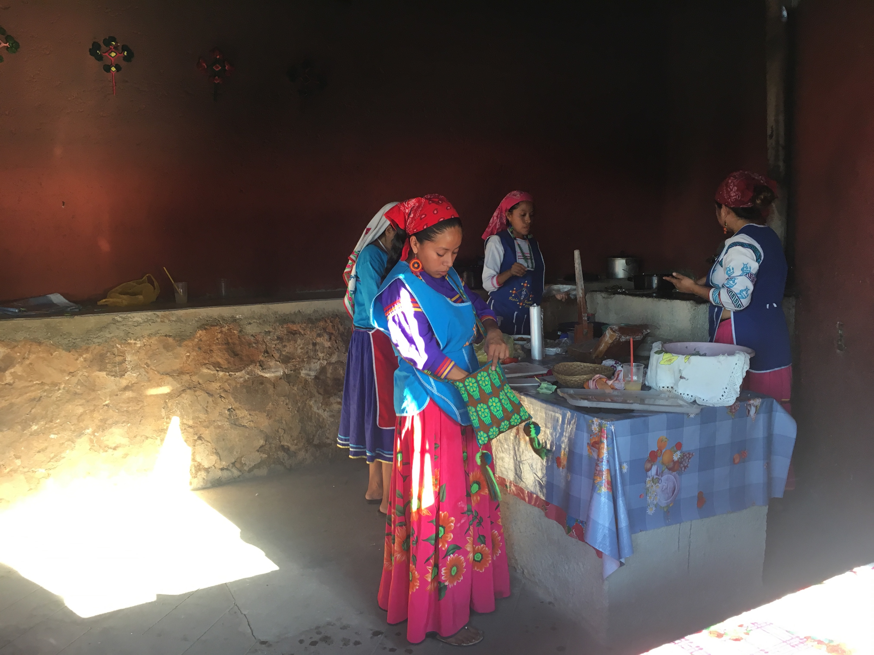
Women and girls are more prone to exposure to chemicals, including persistent and hormone disrupting pollutants which in early years leads to irreversible damage, therefore they need protection.
Current research efforts have observed possible correlations between exposures to environmental toxins and the development of disease and illness, including cancer, reproductive dysfunction, and immunologic and neurologic impairment.

Slide 6
WHAT WOMEN WANT
mainstreaming gender in pollution responses
WMG strongly calls for a Resolution to be introduced on Gender and Pollution, as said before, men and women are impacted differently from pollution
We call for clearer interlinkages from UNEA-3 to the 2030 Agenda for Sustainable Development
Moreover, we advise that Resolutions should not be formulated in silos, but should take into account the close interlinkages among issues in pollution across ecosystems

Slide 7
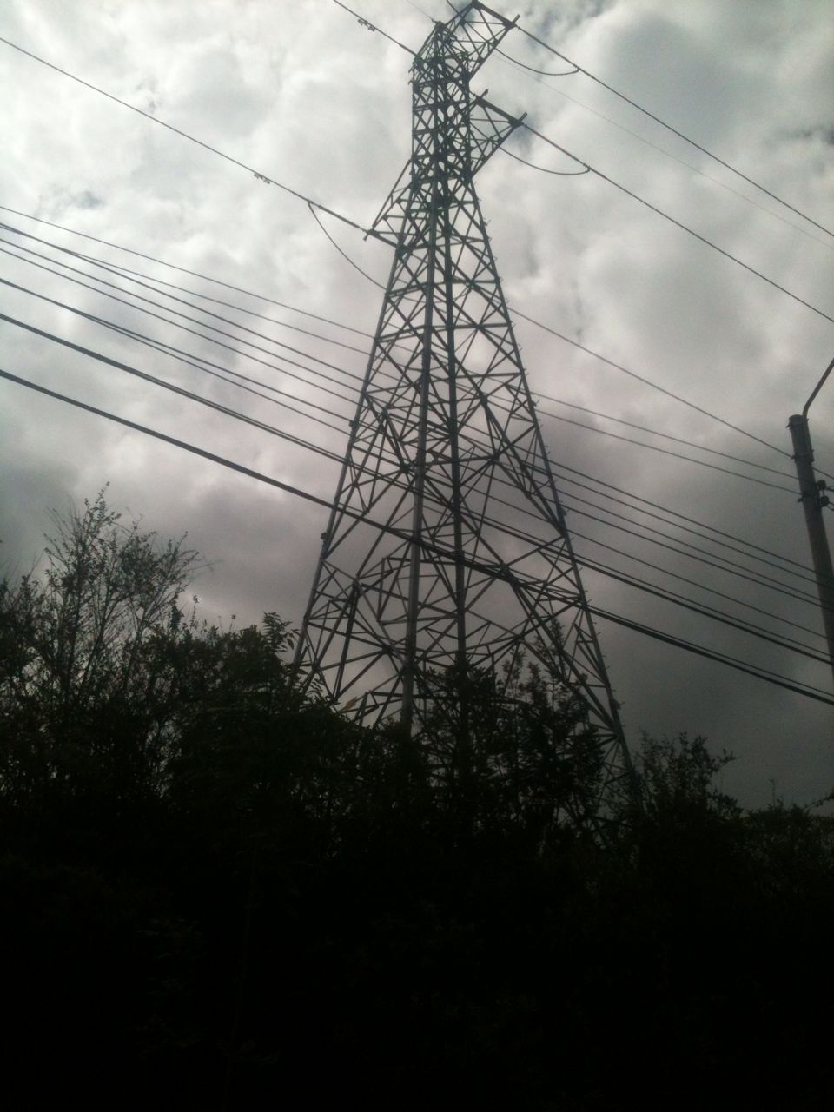
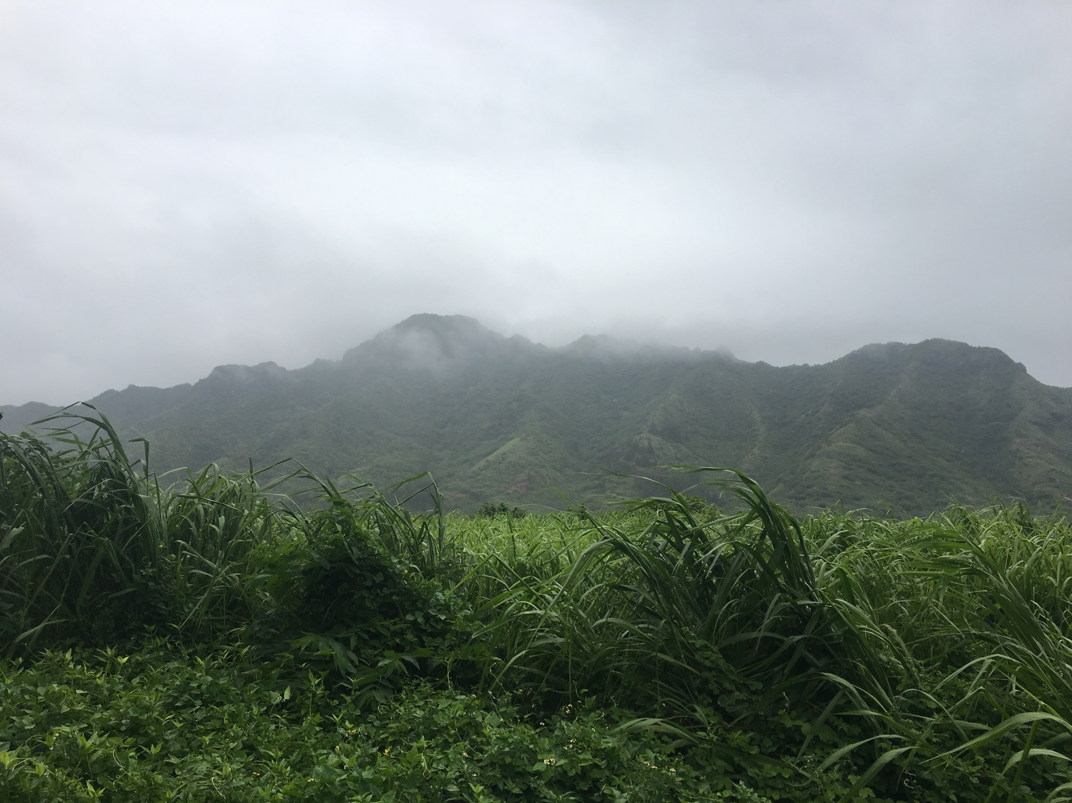
We request for a serious commitment to identify and understand the unique way environmental toxins interact in women and girls’ bodies and lives;
a commitment for countries to understand the impact of chemical exposures in the workplace on the health of women; and an interagency review to evaluate the National risk assessment policy and its impact on women's health.

Slide 8
We expect UNEA-3 to set clear mechanisms for delivering results on SDGs related to pollution and women, and strengthening and enforcing more integrated policies, regulations and laws which are linked to Goal 5 on Gender Equality.
Goal 3.9 on Health & Air pollution failing to specifically mention the gender aspects of this type of pollution, it is clear that achieving a “substantial reduction” of air pollution-related deaths by 2030, requires women’s involvement and improvement of their conditions.
Goal 3.1 ON maternal mortality & 3.2 on neonatal and children mortality also involve gender aspects that have not been clearly spelled out, but that UNEA-3, as an expert agency, can help get attention.

Slide 9
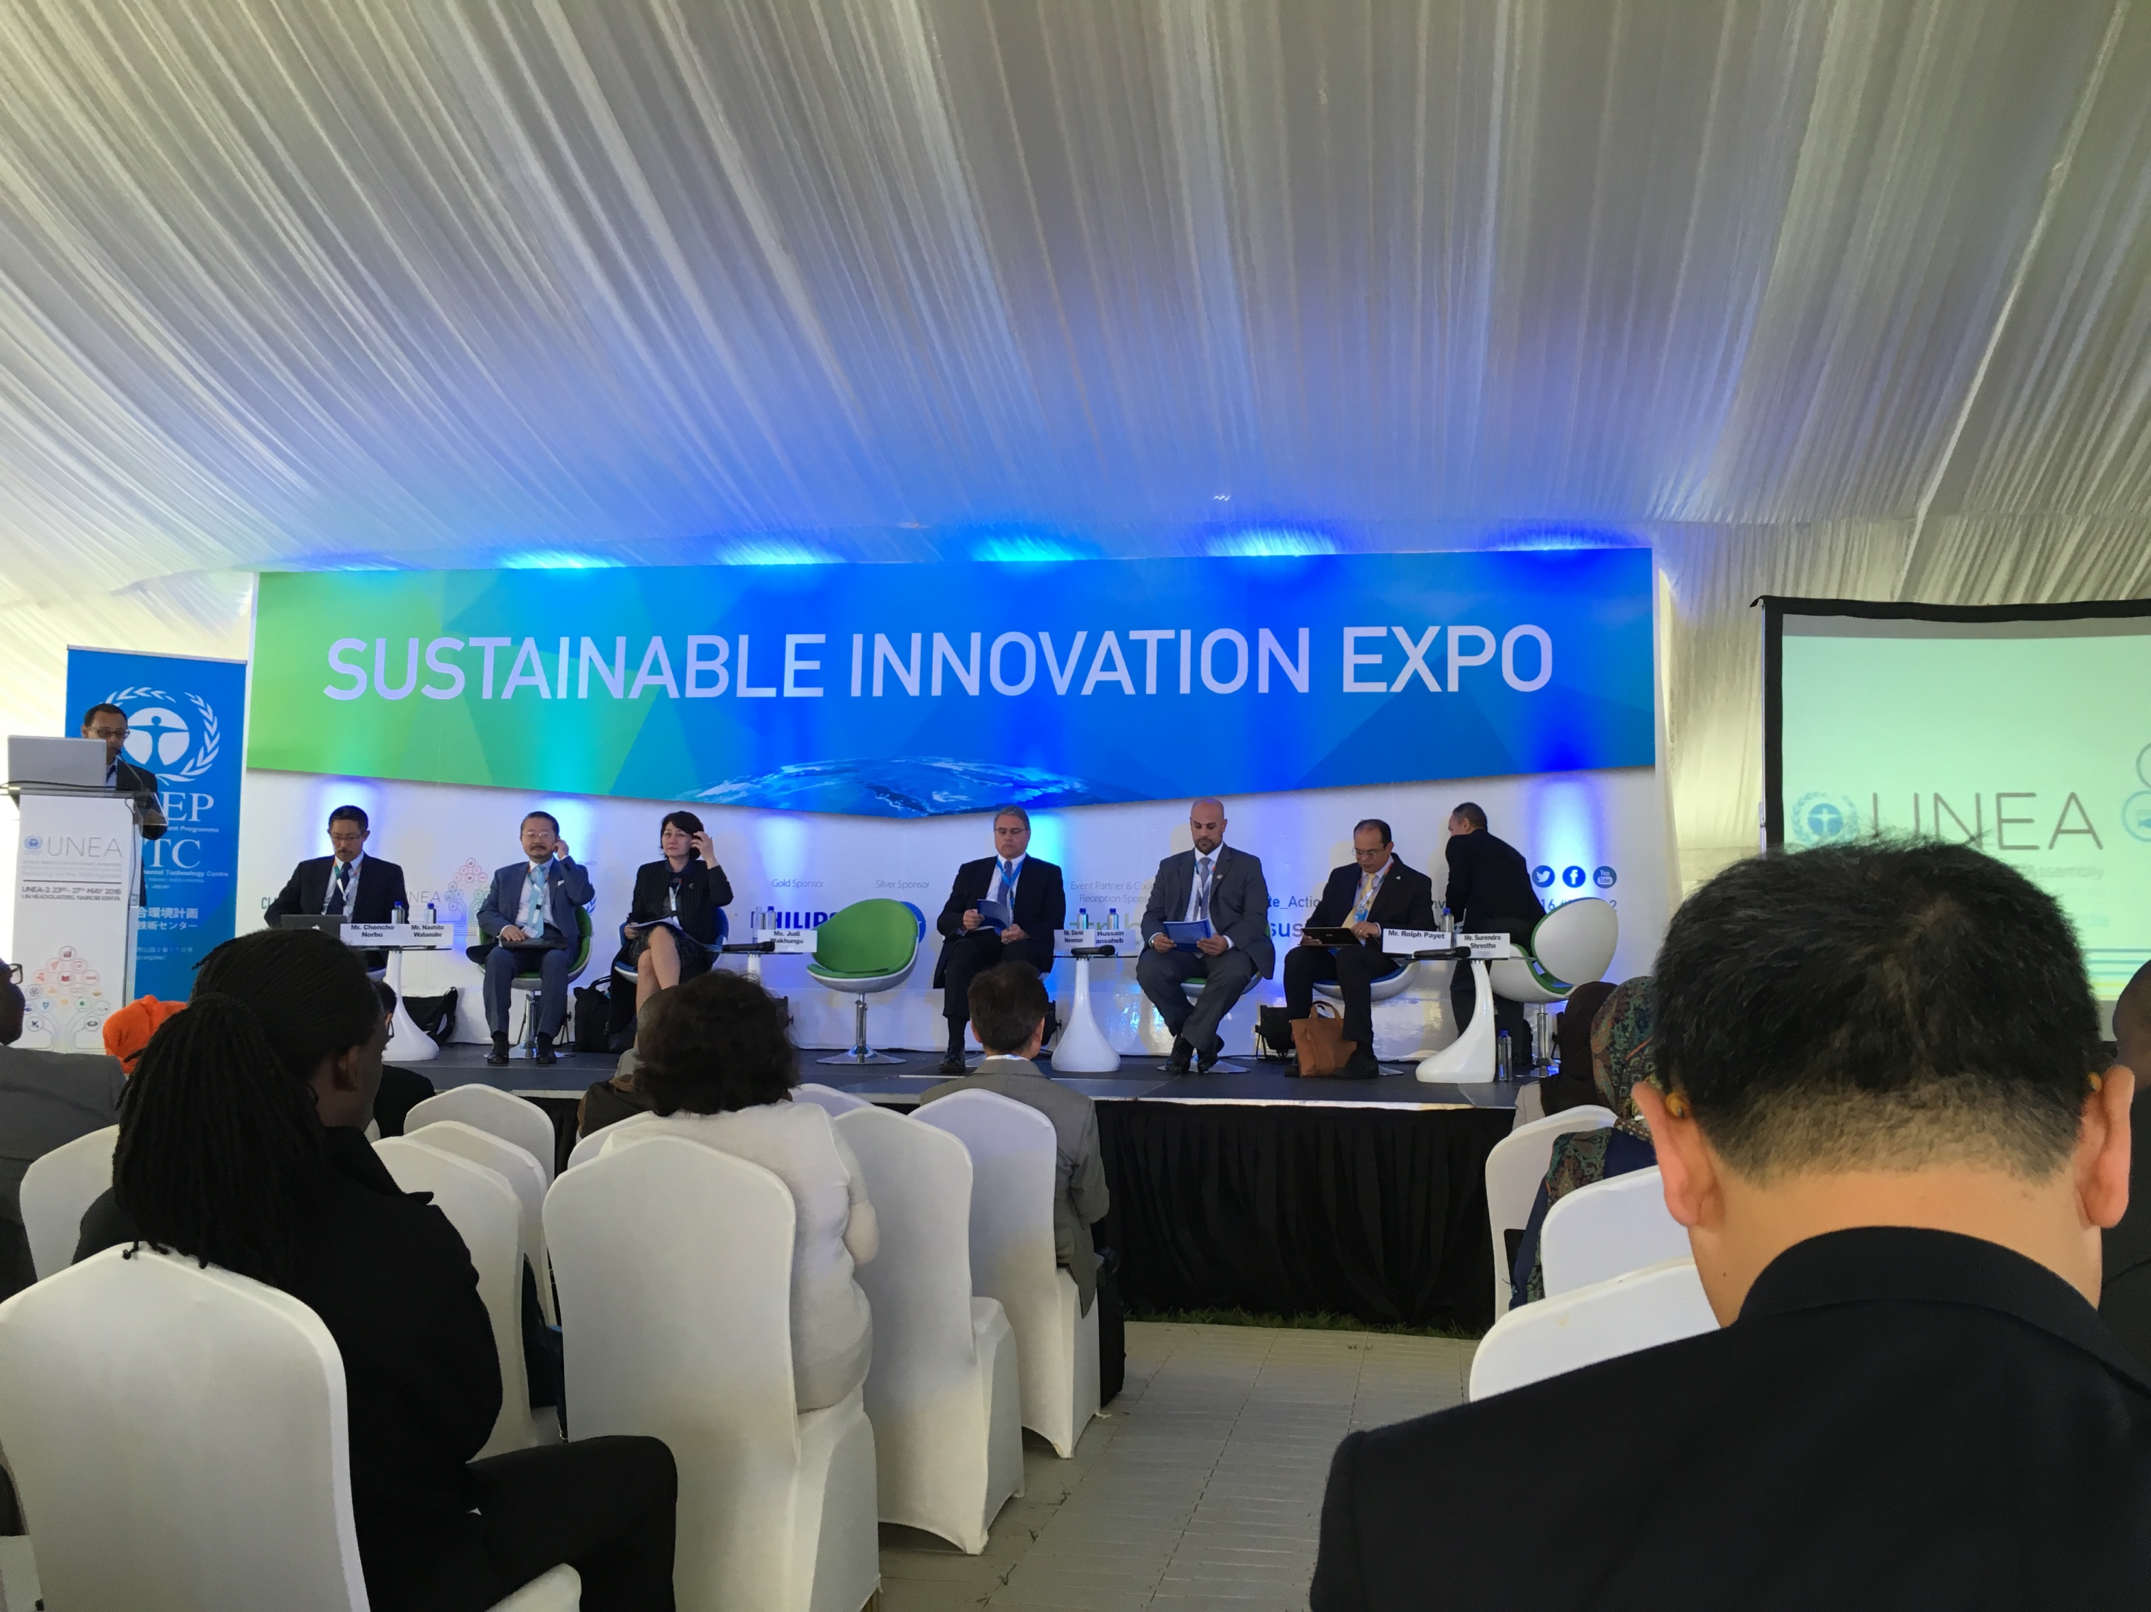
involvement OF government, civil society and all sectors such as a mechanism for participatory and multi-sectoral assessment of technologies to ensure that these will not cause pollution.
Finally, as part of the 9 Major Groups recognized and noting that UNEA-1 & 2 were especially gender blind, we expect that UNEA-3 will address this situation and that UNE will lead the way to future gender-aware UNEA’s. Thank you!
!

